Slide 1
My First Report
File created on: 23-10-2023 22:14:29

Slide 2
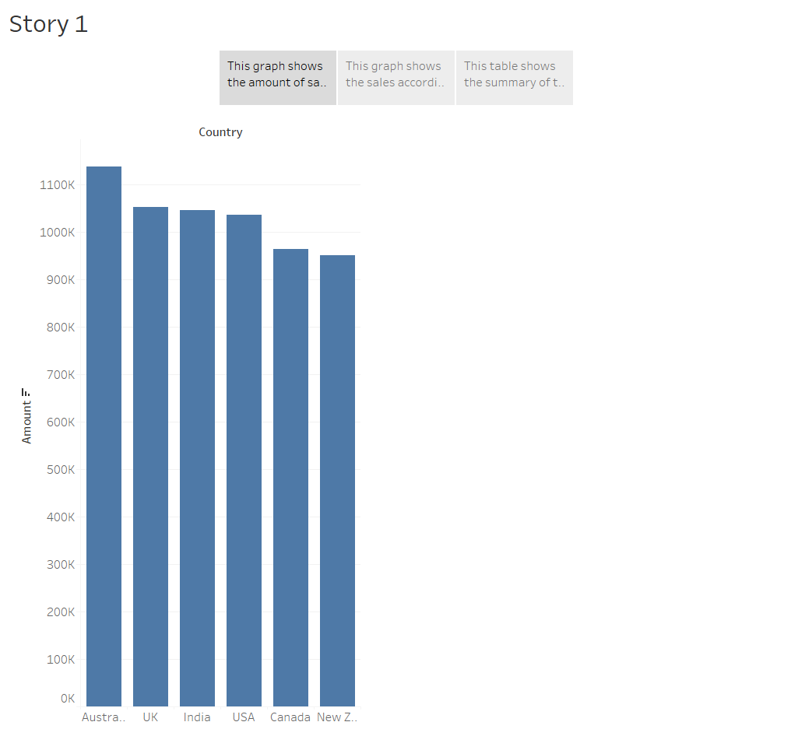

Slide 3
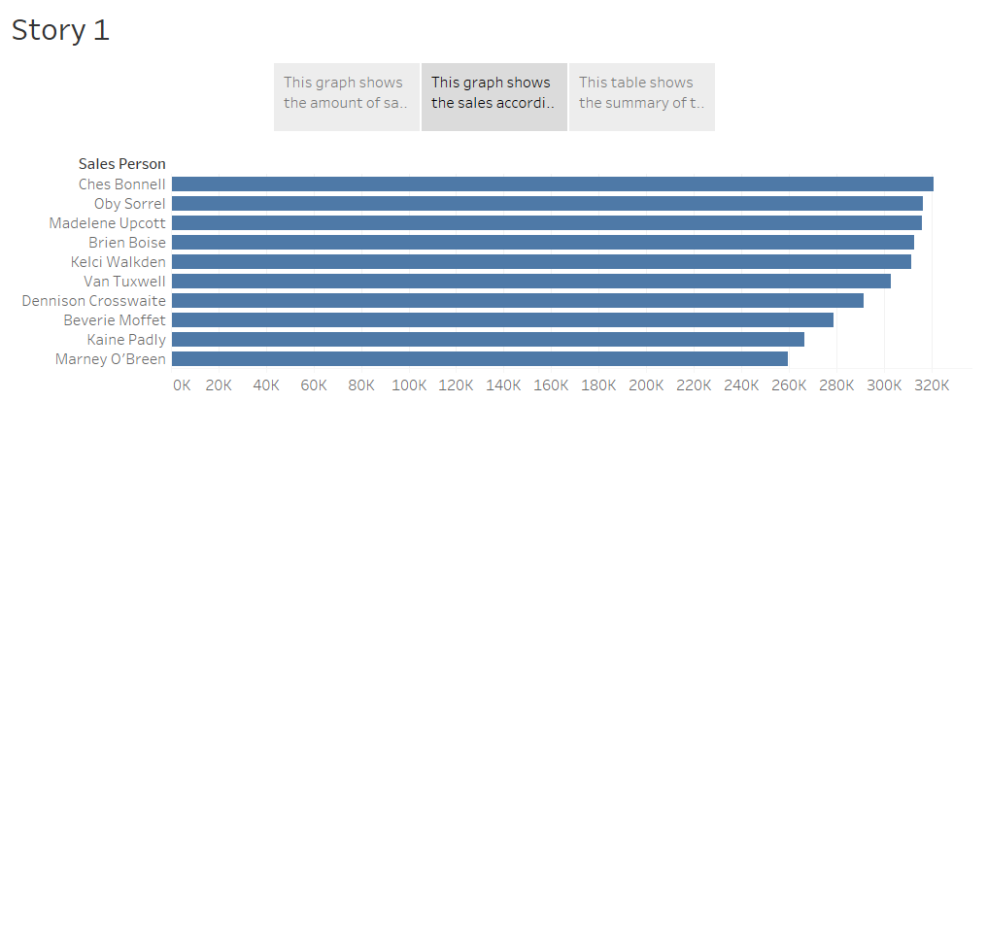

Slide 4
